Slide 1
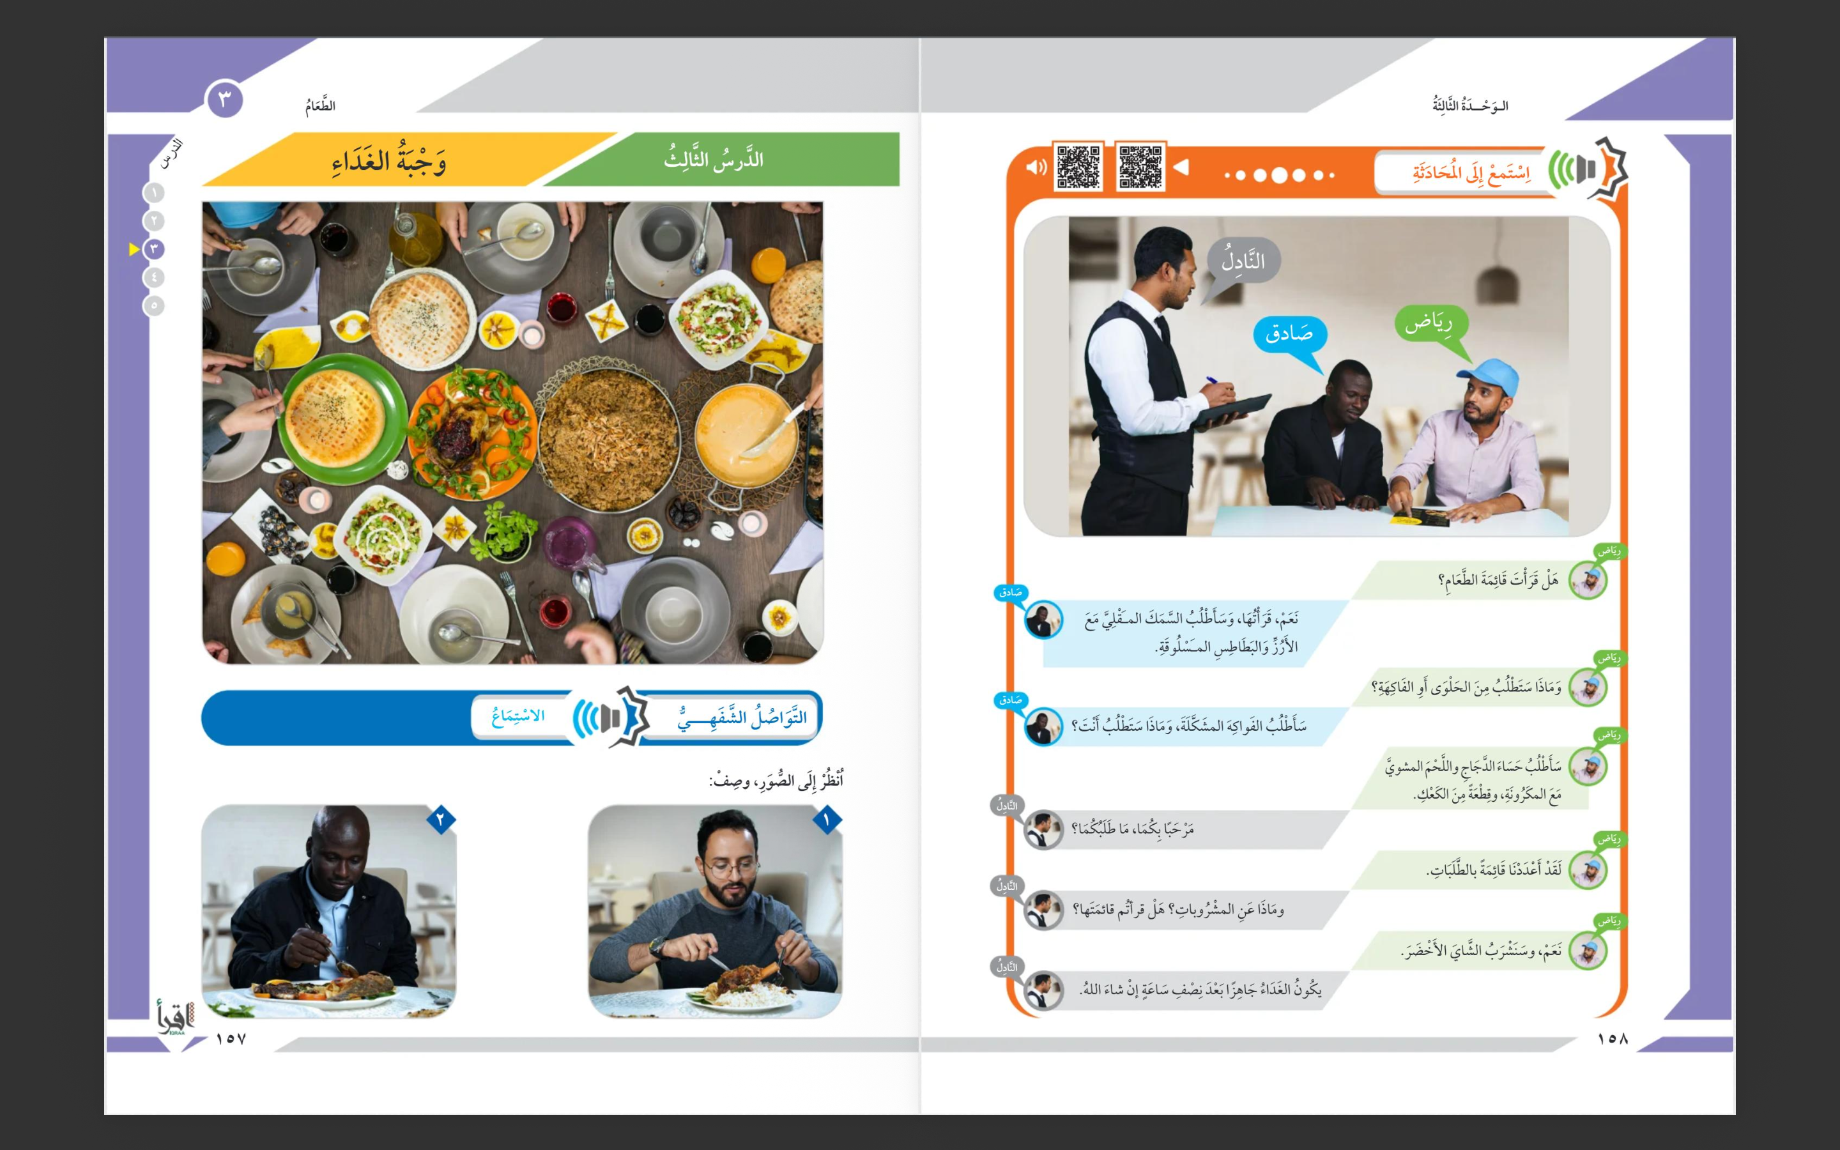

Slide 3
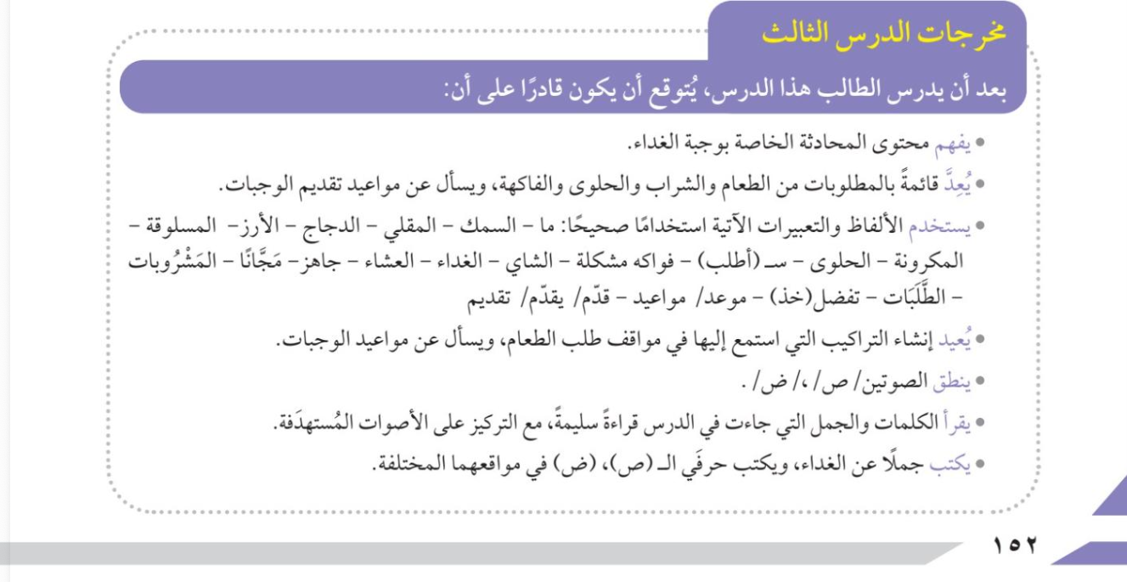

Slide 4


Learning Outcomes
After studying this lesson, the student is expected to be able to:
Understand the content of a dialogue related to a meal.
Prepare a list of requested items (food, drinks, desserts, and fruits) and ask about meal times.
Use the following vocabulary and expressions correctly:
what – fish – fried – chicken – rice – boiled – pasta – dessert – I would like (to order) – fruit – problem – tea – lunch – dinner – ready – free – drinks – orders – prefer (to take) – take – appointment – appointments – serve – serving.
Reproduce the structures heard in food-ordering situations and ask about meal times.
Pronounce the two sounds /s/ and /ṣ/ correctly.
Read the words and sentences from the lesson accurately, with focus on the target sounds.
Write sentences about food and correctly write the letters (ṣ) and (ḍ) in their different positions.

Slide 5


Slide 6
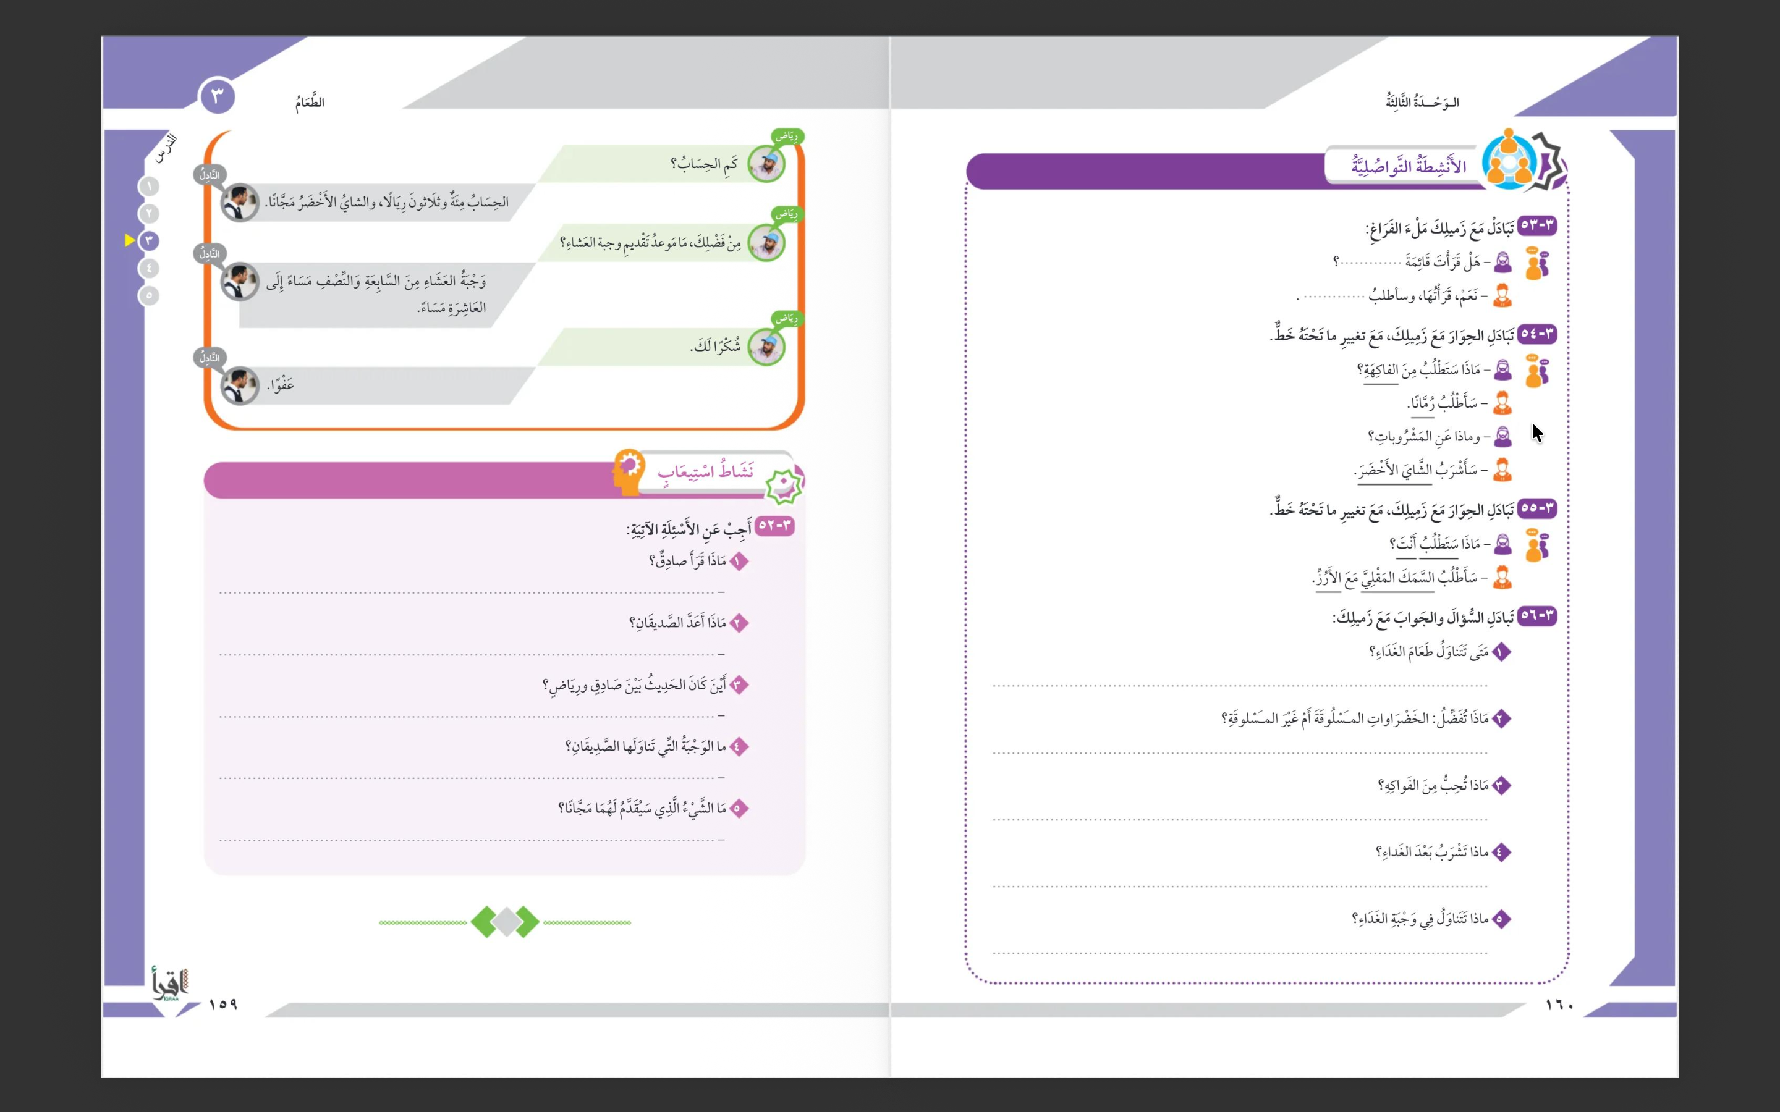

Slide 7
قرأ قائمة الطعام
أعدا قائمة بما يريدان
في المطعم
وجبة الغداء
الشاي الأخضر

Slide 10
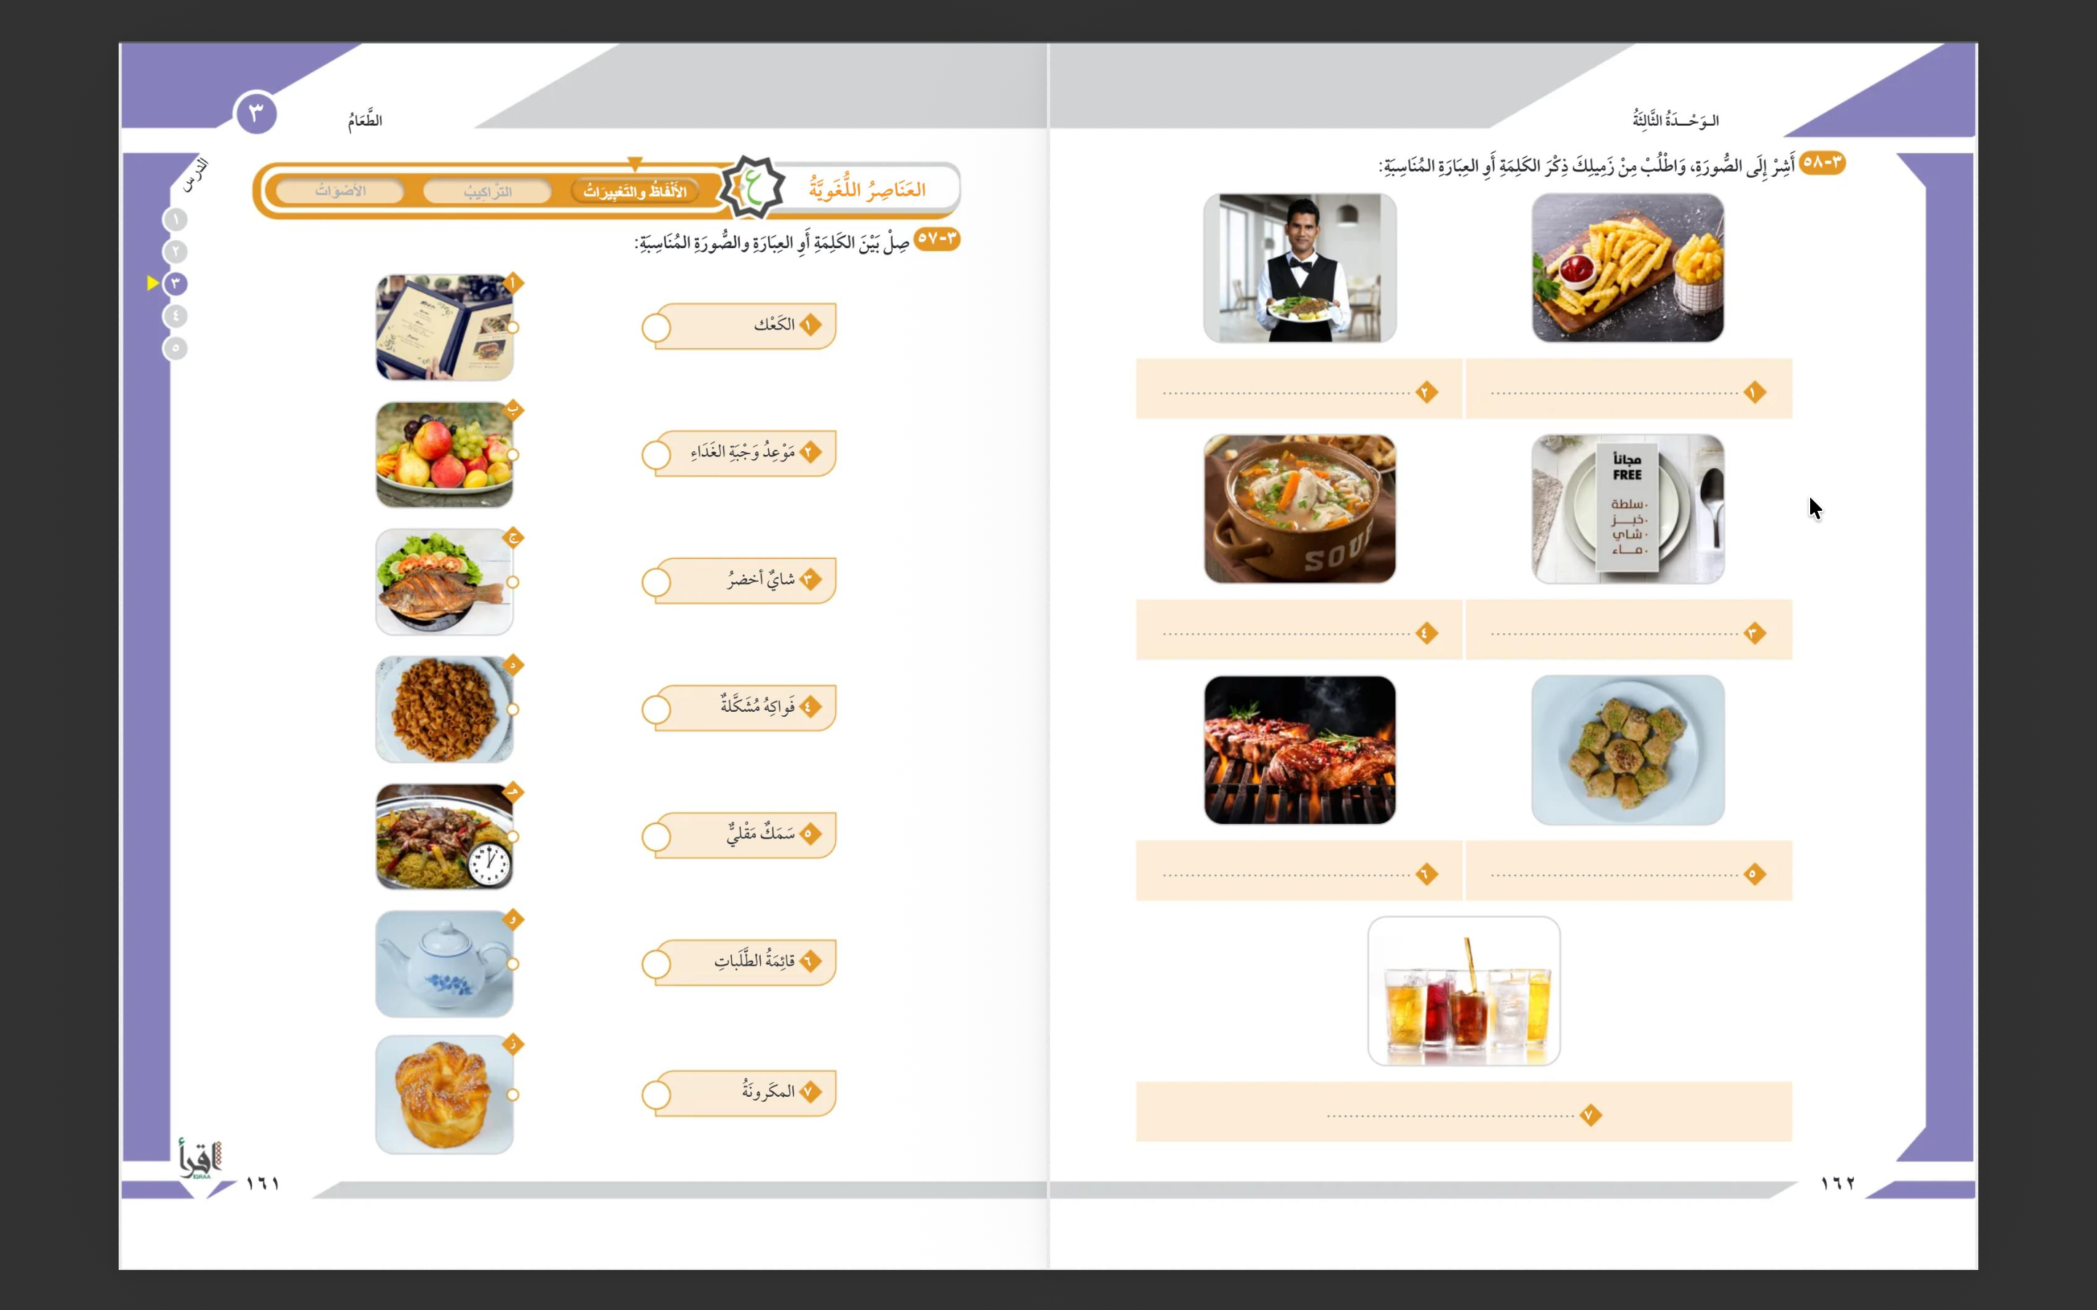
ز
هـ
و
ب
ج
أ
د

Slide 11
النادل
البطاطس المقلية
الحساء الساخن
قائمة الطعام
الدجاج المشوي
الحلويات
العصير

Slide 12
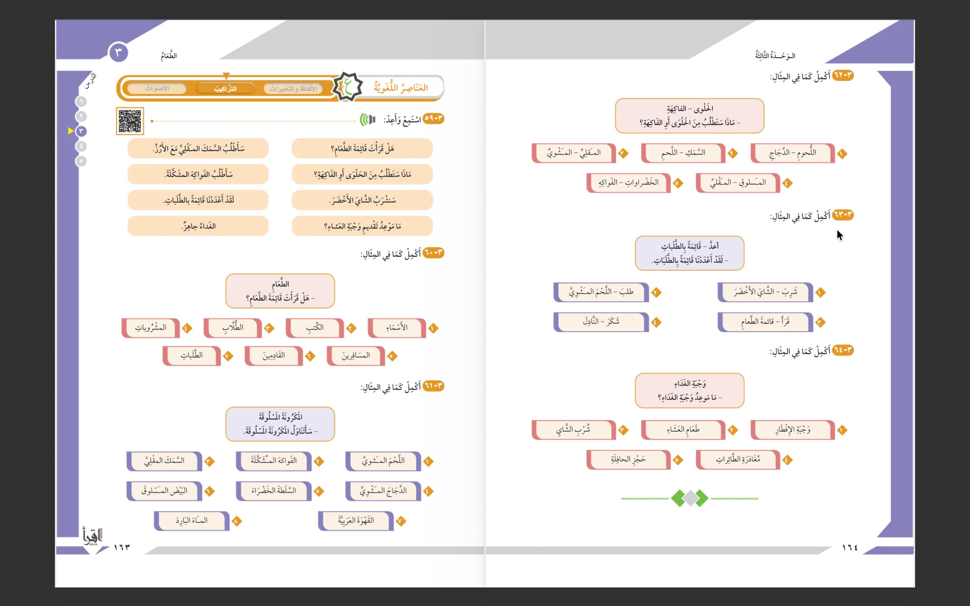

Slide 15
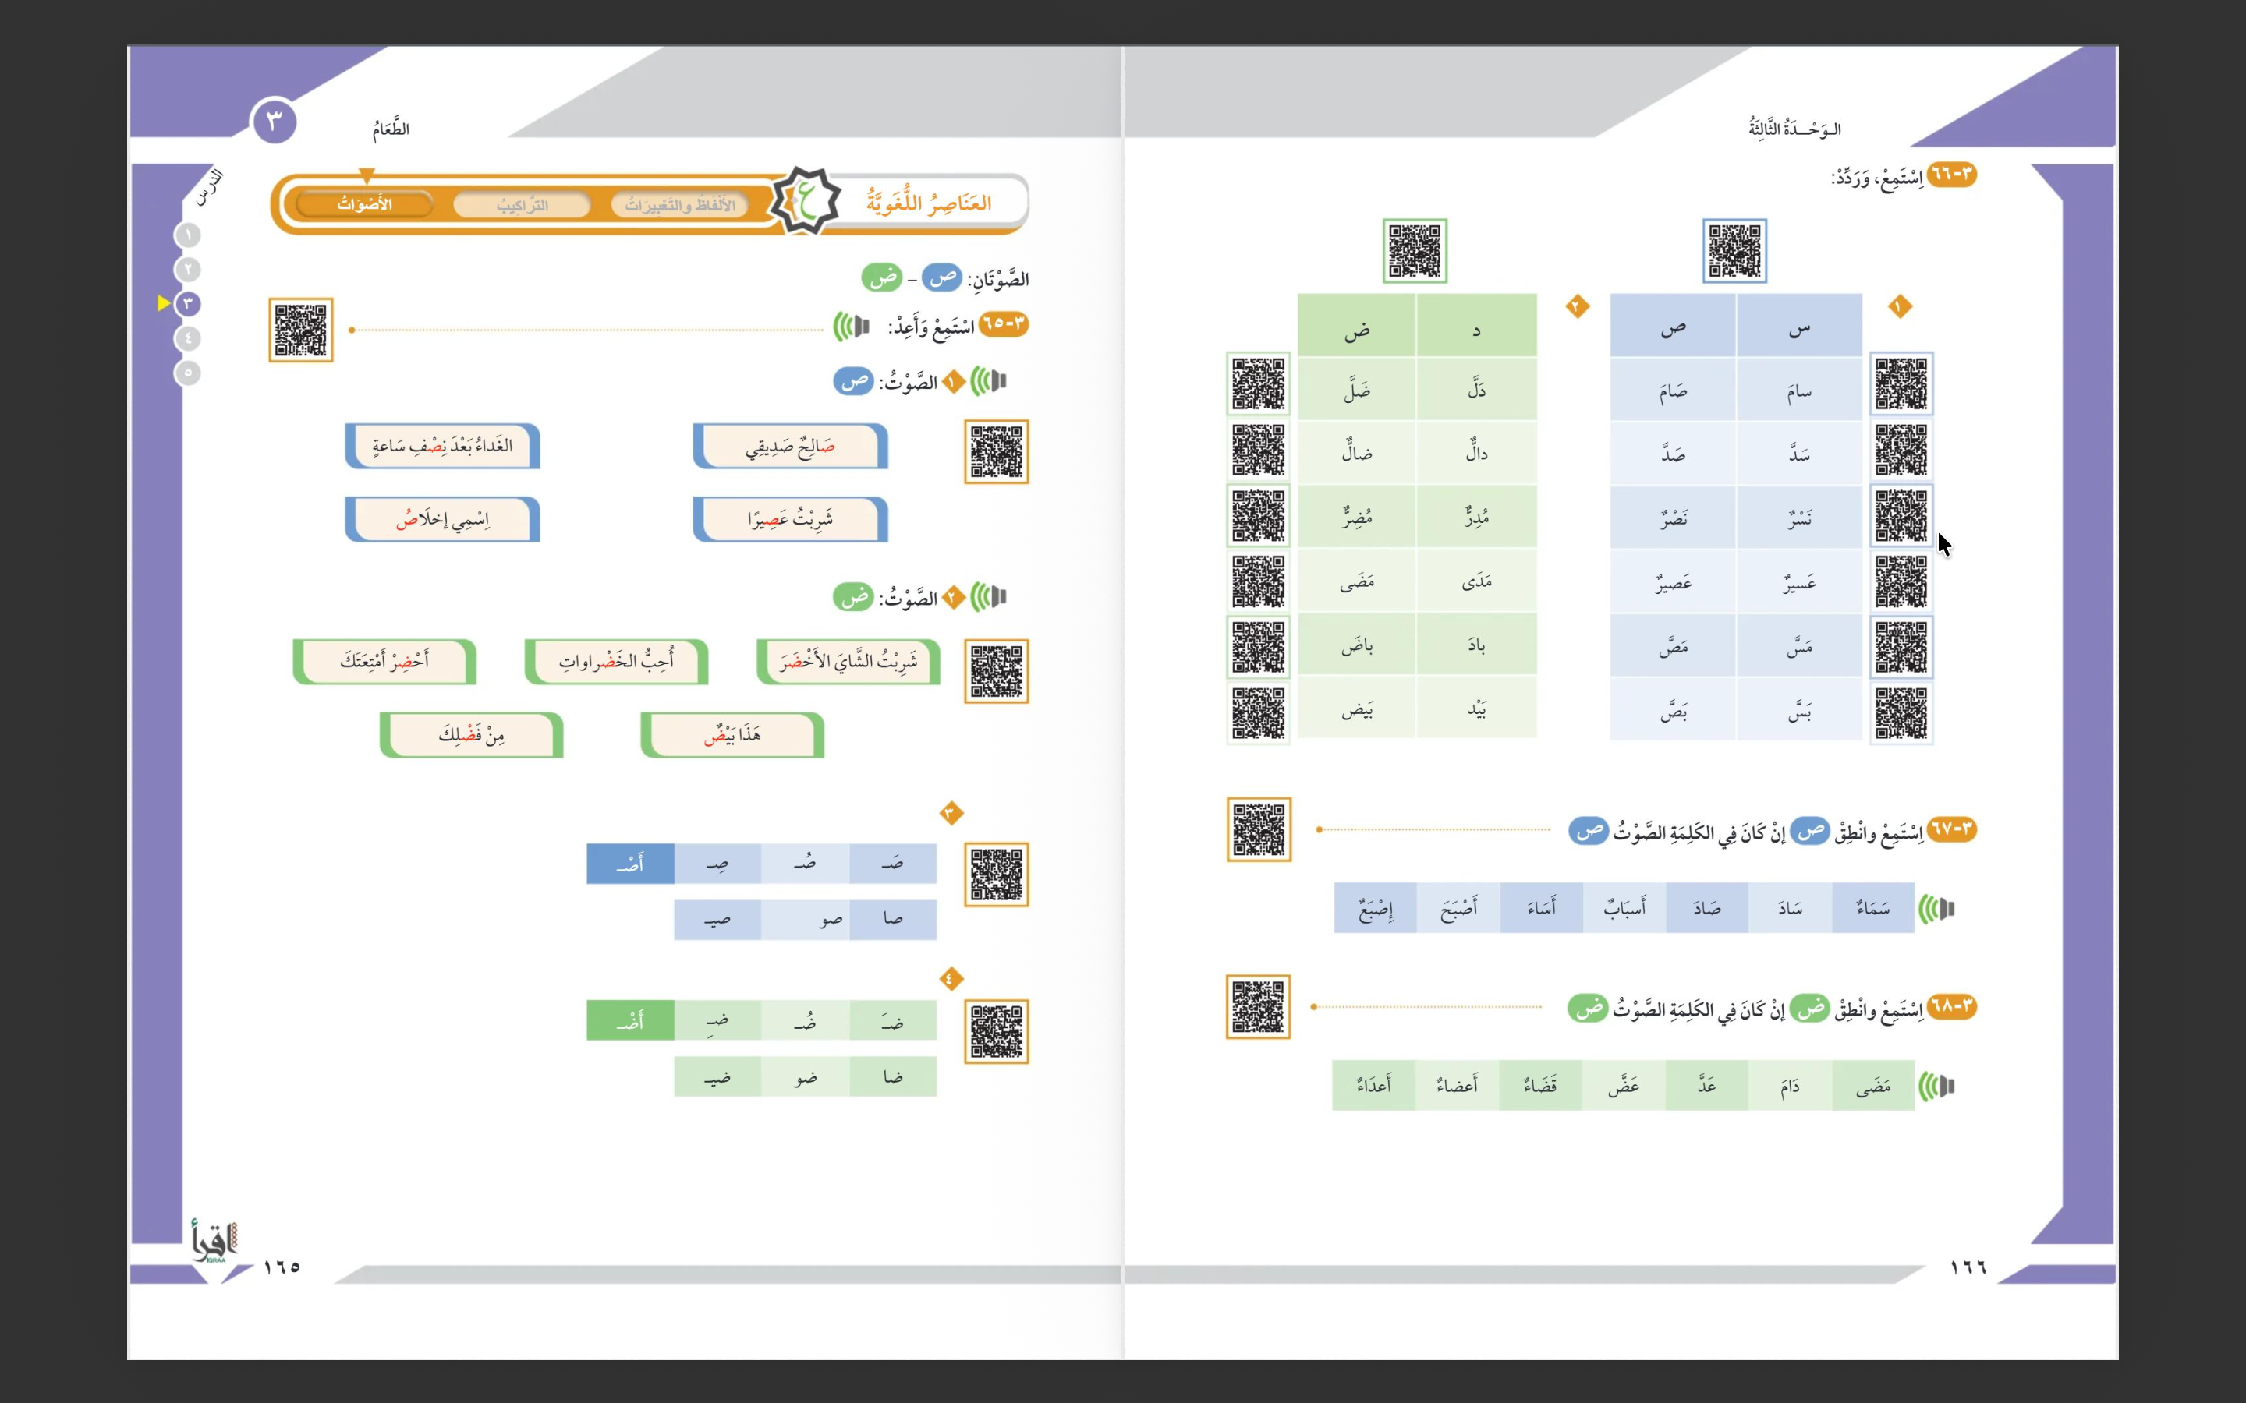

Slide 17
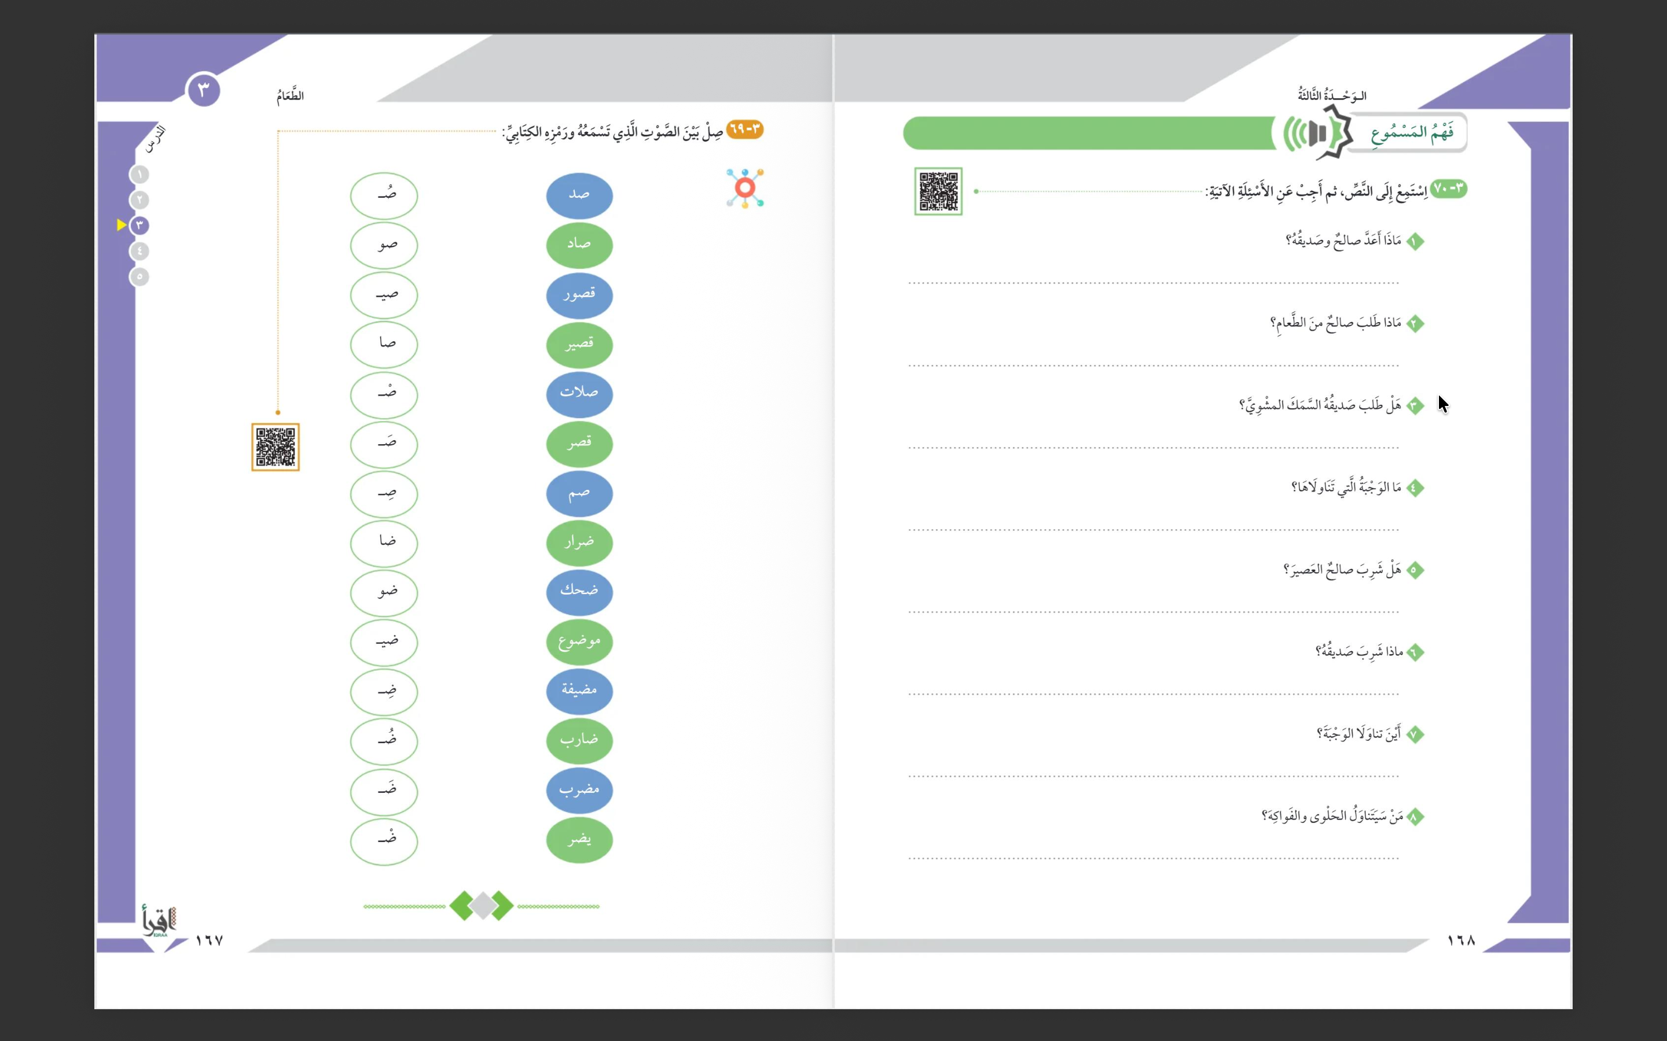

Slide 18
قائمة الطلبات
اللحم المشوي والسلطة الخضراء والشاي والحلوى والفواكه
لا. طلب السمك المقلي
وجبة الغداء

Slide 19
لا، شرب الشاي
شرب القهوة
في المطعم
صالح

Slide 20
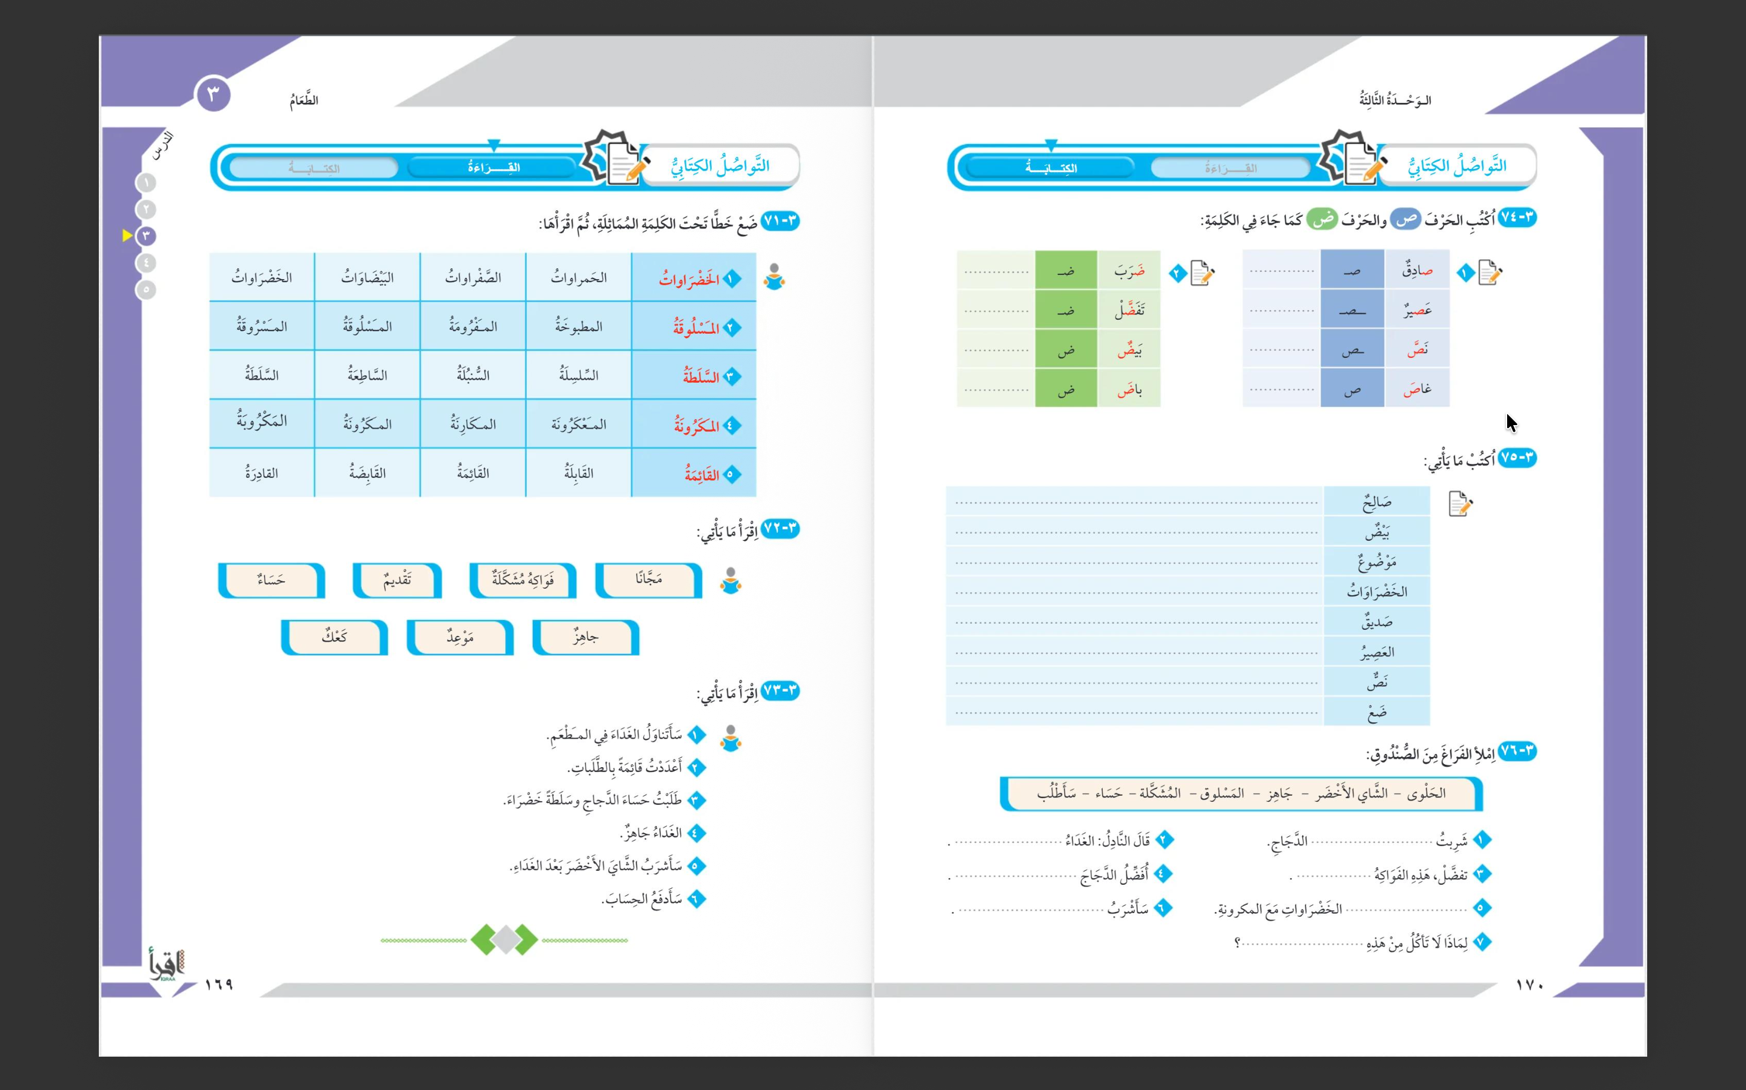

Slide 24
جاهز
حساء
المسلوق
المُشَكَّلةُ
الشاي الأخضر
سأطلب
الحلوى

